Slide 1


Automating As-Built and GIS Data Requests
Michael Hanson
GIS/Asset Management Technician
City of Rosemount

Slide 2
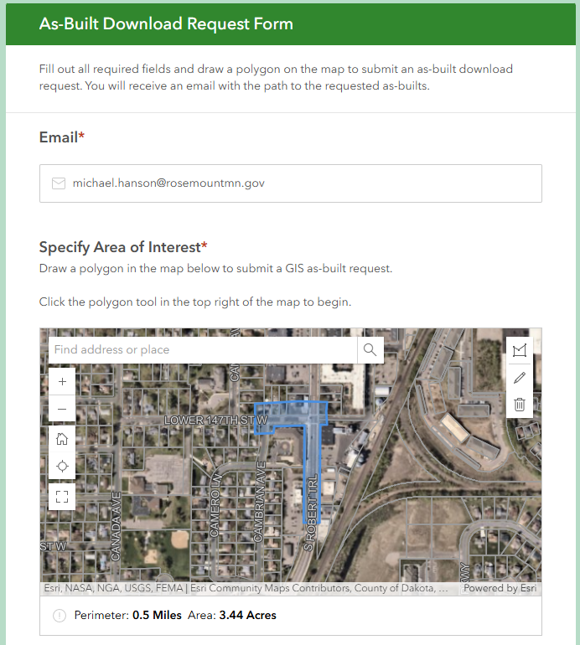

Overview
Background
Request for Automated Tool
Challenges
Other Options and Considerations
Permissions Handling
Solution
Survey123
Power Automate
Python
Tracking
Github: Code/PPT

Slide 3
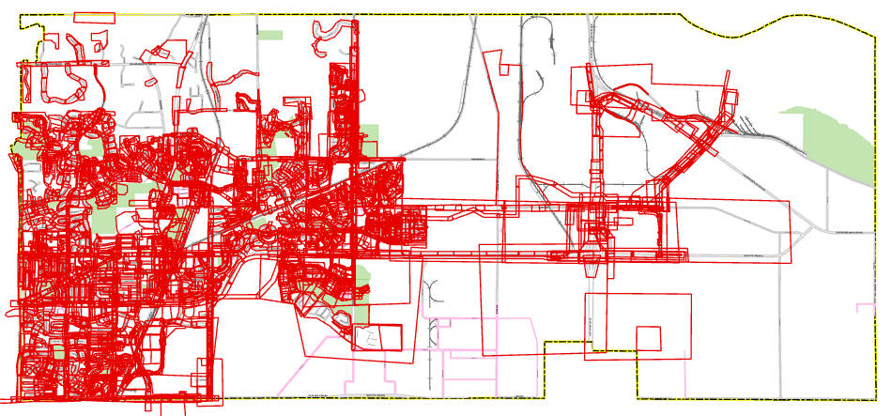
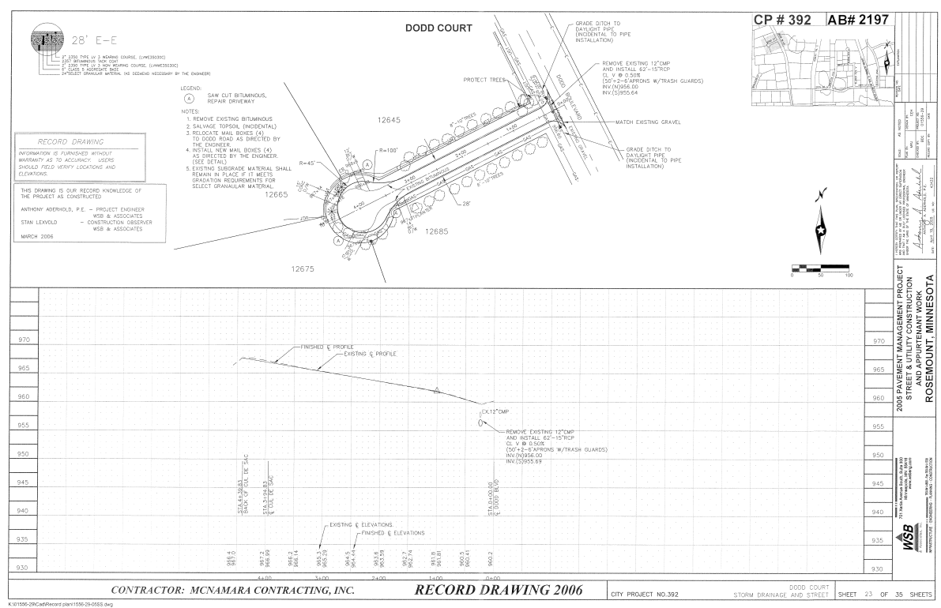
Background – Plan area layer
Utility as-built pages are extracted, stamped, and their extent digitized to a ‘Plan Areas’ layer
Each page is saved to a Sharepoint folder with name format:
{as-built #}.pdf
A hyperlink concatenates automatically in the Plan Areas layer using attribute rules
Github: Code/PPT
Notes:
Each page of every as-built we receive is stamped with an as-built number. The extent of that page is added to a Plan Areas feature class, which allows spatial and/or attribute querying of as-built records.

Slide 4
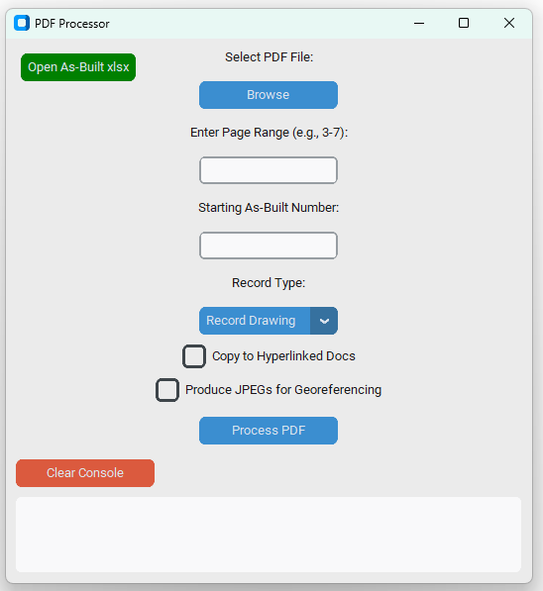

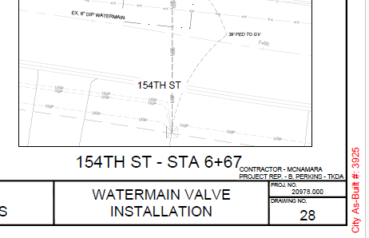
Plan Area Layer – As-Built Extractor Tool
Stamps specified pages with sequential as-built numbers
Extracts each page to pdf
Saves pdf’s to Sharepoint directory (optional)
Produces JPEG’s (optional)
https://github.com/m-hanson-5/PDF_Extractor
Python modules: PyPDF2, reportlab, fitz, PIL, customtkinter

Slide 5
Plan area layer - Fields
Field Schema:
ID (As-Built #; this field is used to relate to other layers’ as-built references)
Hyperlink
Water (y/n)
Sanitary (y/n)
Storm (y/n)
Grading (y/n)
Project Number
Project Name
Install Year
Plan Type (Record Drawing, Construction Plan, Private Plan)
Github: Code/PPT

Slide 6
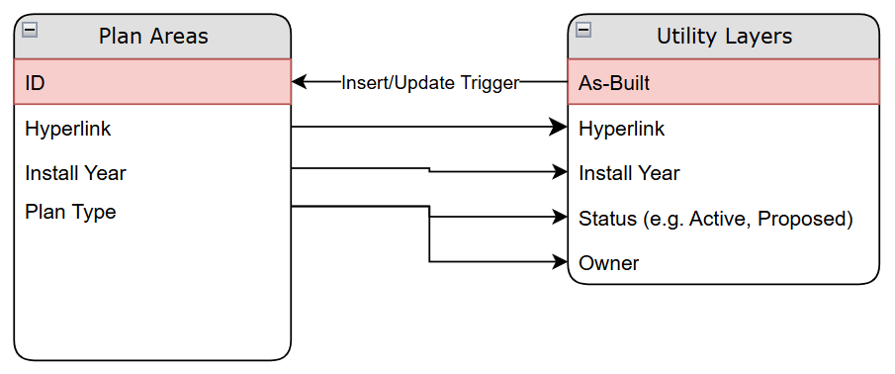
Plan area layer – Attribute Rules
Github: Code/PPT
Notes:
Plan Areas are a place to store project level data that can be absorbed by other features referencing that as-built

Slide 7
The Tool
Requirements:
Web interface. No login needed
Tool accepts a polygon input
Validation process to ensure requester has permission to access data
Output is an emailed link to a Sharepoint folder with as-built pdf’s and GIS files (if specified)
Github: Code/PPT

Slide 8
Challenges
Process begins online but must access local files
Permissions Handling
SOLUTIONS CONSIDERED:
Add script to a toolbox and share as a Web Tool (Geoprocessing Service)
Difficult to customize without Javascript, same issue of file management from web tool
Power Automate Premium
Allows use of Power Automate Desktop in ‘unattended mode’
Can run a local script in response to a trigger
$$$
✅ Python script on a polling interval using Task Scheduler
Github: Code/PPT

Slide 9
WORKFLOW
Survey123
Power Automate
Python
User draws a polygon
in Survey123
Power Automate detects the submission
Sends an email to the user
acknowledging submission
Creates a GIS Ticket for tracking
Python script polls for changes to the Survey123 layer and processes the request
Github: Code/PPT

Slide 10
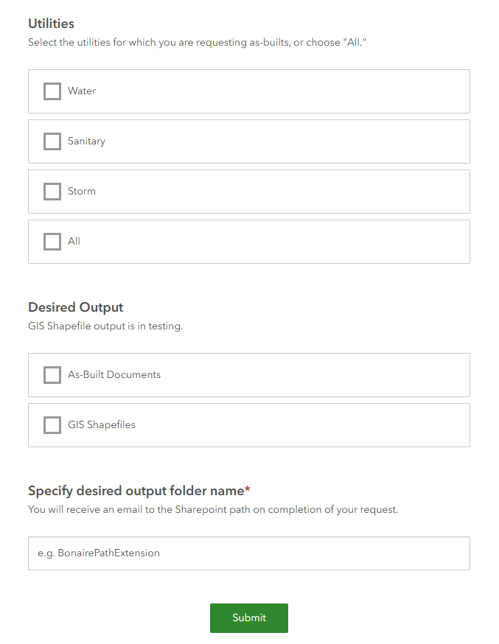
Survey123
Github: Code/PPT
As-Built Download Request Form

Slide 11
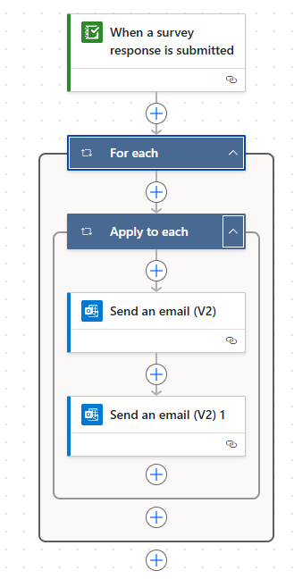
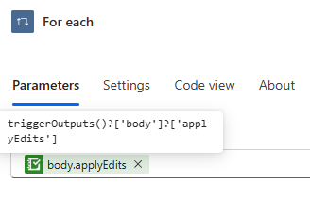
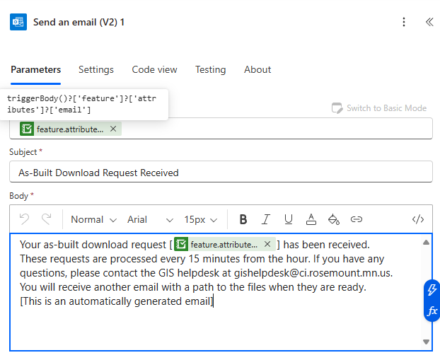
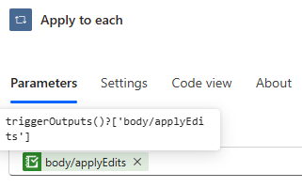
Power Automate Flow
Note: the final email with the link to the files comes from Python script
Github: Code/PPT

Slide 12
Example of Email to GIS HelpDesk
A new request with request id 200004367 has been created by Public Works. Short info on the request is : Title : A new as-built download request has been submitted. Category : Description :A new as-built download request has been submitted.
Requestor Email:<derick.anderson@rosemountmn.gov>
Desired Output Location: <DCTC>
Global ID: {DD597079-7605-46B6-8CC6-194F0E5BFA98}
You may fulfill the download request immediately by running the below script:
\Automation\As-Built_Auto_Downloader.py
As-Built Request Tracker
Github: Code/PPT

Slide 13
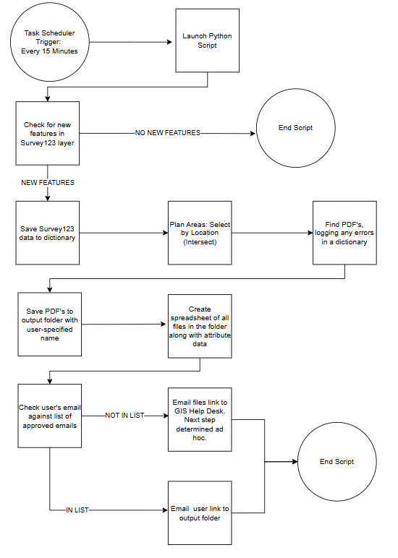
Python
View Code on GitHub:
https://github.com/m-hanson-5/As-Built-Downloader
Github: Code/PPT
Python modules: arcpy, pandas, logging
Notes:
Logging and error handling with try/except blocks and email alerts

Slide 14
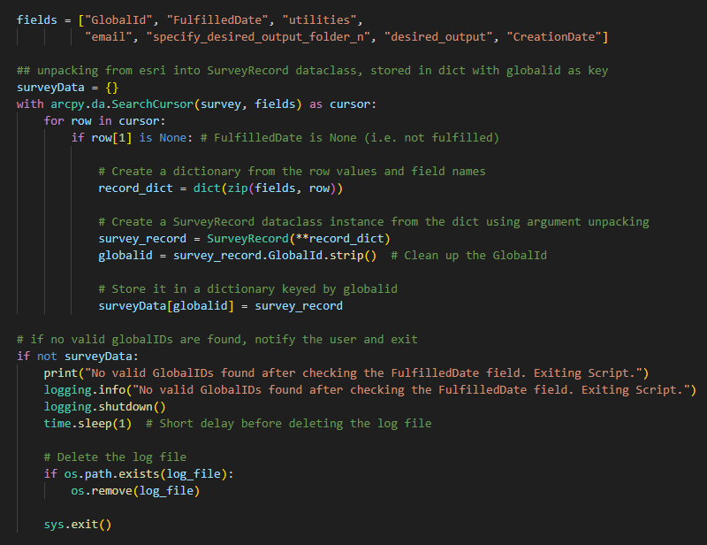
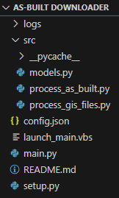
Python
Github: Code/PPT

Slide 15
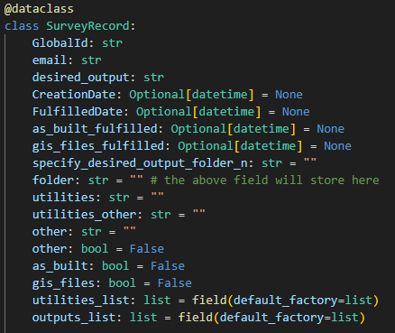
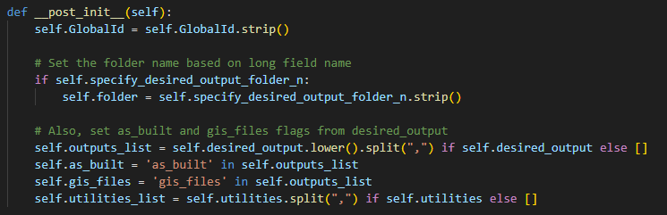
Python
Github: Code/PPT

Slide 16
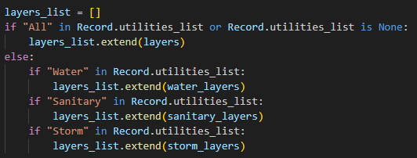
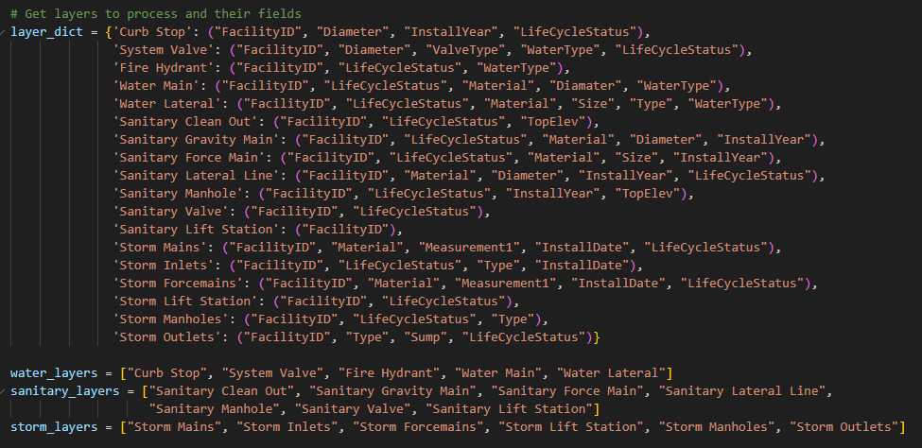
Python – Managing Fields Shared in GIS Files
Github: Code/PPT

Slide 17
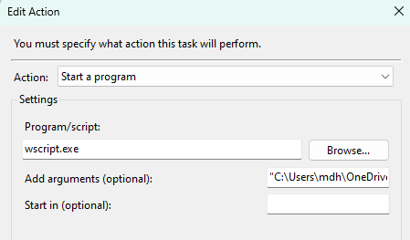
Task Scheduler – Silent Operation
Method with a .vbs file below, though .bat is also possible
vbs file content:
Task Scheduler:
.vbs file
Set WshShell = WScript.CreateObject("WScript.Shell") WshShell.Run """C:\Program Files\ArcGIS\Pro\bin\Python\envs\arcgispro-py3\python.exe"" ""C:\Users\mdh\OneDrive - ci.rosemount.mn.us\GIS Projects\Automations\As-Built_Auto_Downloader.py""", 0
Path to .vbs file
Alternatives for silent operation:
‘Run whether user is logged in or not’
Pythonw.exe
‘start /B’ in .bat file
Github: Code/PPT

Slide 18
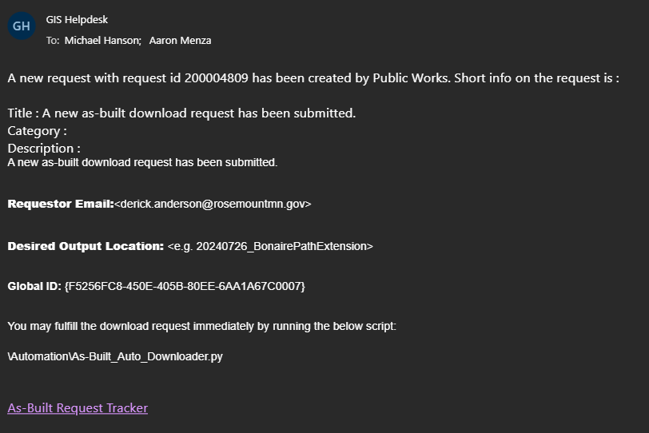
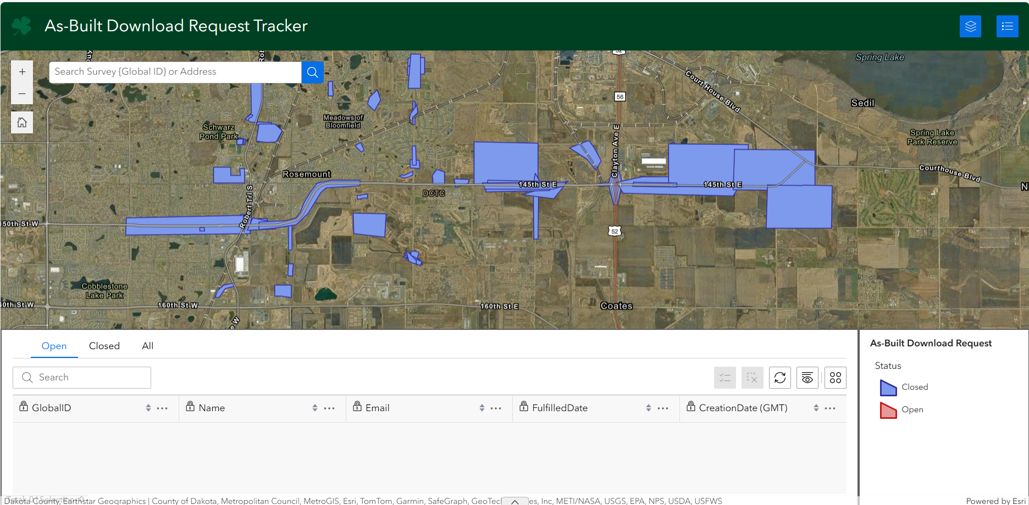
Tracker App
As-Built Download Request Tracker
Experience Builder app to track open tickets

Slide 19

Questions?
Github: Code/PPT

